Slide 1

Cyber Security and
Ethical Hacking
Webinar
Subodh Shrivastava
Institute of Computer Science

Slide 2
Cyber Security

Slide 3

What is Cyber Security
Protection of Network and Data from unauthorized access.
Protection of your online and offline identity
Protection of your information such as financial, social, or business plans etc.

Slide 4

Information
Online Services and Extensive Use of Internet, Businesses, Stock Markets, Economies and Governments
These have all changed the way people live and use technology
This in turn has increased the information flows, and collection of data that arises daily.
Electronic (digital) storage of data by users and organisations results in the need for a way to handle the exponential increase of data.

Slide 5

Personal Data
Your Data
Medical Records
Education Records
Employment and Financial Records
Social Relationship Data
Hobbies
Like and Dislike

Slide 6

Organizational Data
Traditional Data
Personnel – application materials, payroll, offer letter, employee agreements
Intellectual – patents, trademarks, product plans, trade secrets
Financial - income statements, balance sheets, cash flow statement
Internet of Things and Big Data
Iot – Large network of physical objects, such as sensors
Big Data – data from the IoT

Slide 7
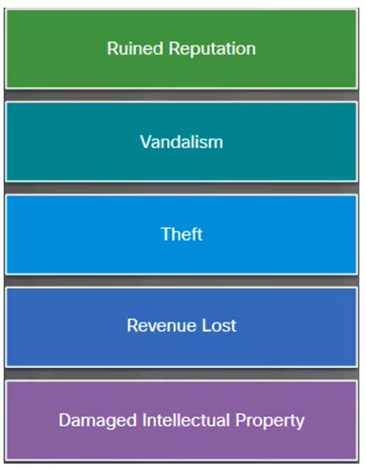
The Impact of a Security Breach
The Consequences
Not feasible to prevent every attack
Attackers will always find new ways
Ruined reputation, vandalism, theft, revenue lost, damaged intellectual property

Slide 8
Type of Attackers
Attackers Profiles
Amateurs
Hackers
Organized Hackers
Script Kiddies with little or no skill
♦
Using existing tools or instructions found online for attacks
White hats - Break into system with permission to discover weaknesses so that the security of these systems can be improved
♦
Gray hats - Compromise systems without permission
♦
Black hats - take advantage of any vulnerability for illegal personal, financial or political gain
Organizations of cyber criminals, hacktivists, terrorists, and state-sponsored hackers
.

Slide 9
Terminology
DDoS
Social Engineering
Cross-site Scripting (XSS)
Trojan
Botnet
Brute force Attack
Buffer Overflow
Clone phishing
Denial of service attack(DoS)
Notes:
Botnet - A botnet, also known as zombie army, is a group of computers controlled without their owners’ knowledge. Botnets are used to send spam or make denial of service attacks.
Brute force attack − A brute force attack is an automated and the simplest kind of method to gain access to a system or website. It tries different combination of usernames and passwords, over and over again, until it gets in.
Buffer Overflow − Buffer Overflow is a flaw that occurs when more data is written to a block of memory, or buffer, than the buffer is allocated to hold.
Clone phishing − Clone phishing is the modification of an existing, legitimate email with a false link to trick the recipient into providing personal information.
Denial of service attack (DoS) − A denial of service (DoS) attack is a malicious attempt to make a server or a network resource unavailable to users, usually by temporarily interrupting or suspending the services of a host connected to the Internet.
DDoS − Distributed denial of service attack.
Social engineering − Social engineering implies deceiving someone with the purpose of acquiring sensitive and personal information, like credit card details or user names and passwords.
Cross-site Scripting − Cross-site scripting (XSS) is a type of computer security vulnerability typically found in web applications. XSS enables attackers to inject client-side script into web pages viewed by other users.
Trojan − A Trojan, or Trojan Horse, is a malicious program disguised to look like a valid program, making it difficult to distinguish from programs that are supposed to be there designed with an intention to destroy files, alter information, steal passwords or other information.

Slide 10
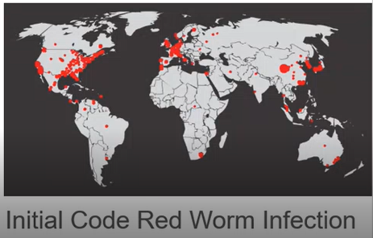
Types of Malware
Malware is used to steal data, bypass access controls, cause harm to, or compromise a system.
Spyware - track and spy on the user
Adware - deliver advertisements, usually comes with spyware
Bot - automatically perform an action
Ransomware - hold a computer system or the data captive until payment is made
Scareware - persuade the user to take a specific action based on fear

Slide 11
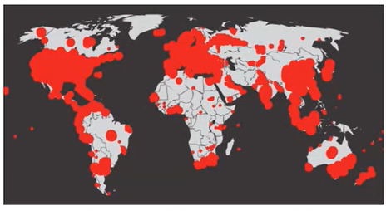
Types of Malware
Rootkit - Modify the operating system to create a backdoor
Virus - malicious executable code that is attached to other executable files
Trojan horse - carries out malicious operations under the guise of the desired operation
Worm - replicate themselves by independently exploiting vulnerabilities in networks
Man-in-The-Middle or Man-in-The-Mobile - take control over a device without the user's knowledge
Code Red after 19 hours

Slide 12

Symptoms of Malware
There is an increase in computer CPU usage
There is a decrease in computer speed
The computer freezes or crashes often
There is a decrease in Web browsing speed
There is an unexplainable problem with network connection
Files are modified
Files are deleted
There is a presence of unknown files, programs or desktop icons
There are unknown processes running
Programs are tunning off or reconfiguring themselves
Email is being sent without the user's knowledge or consent

Slide 13
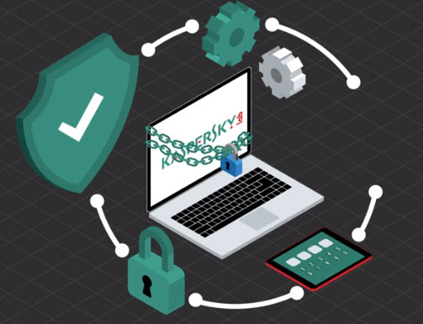
Protection - Individual
Keep all software up to date
Don’t use a weak password
Avoid accessing bank sites in a public place
Don’t do banking or work on the sensitive information on public Wi-Fi
Use good Anti-virus
Encrypt Hard disk
Check the website for HTTPS
Do not click on the email links
Back up your data

Slide 14
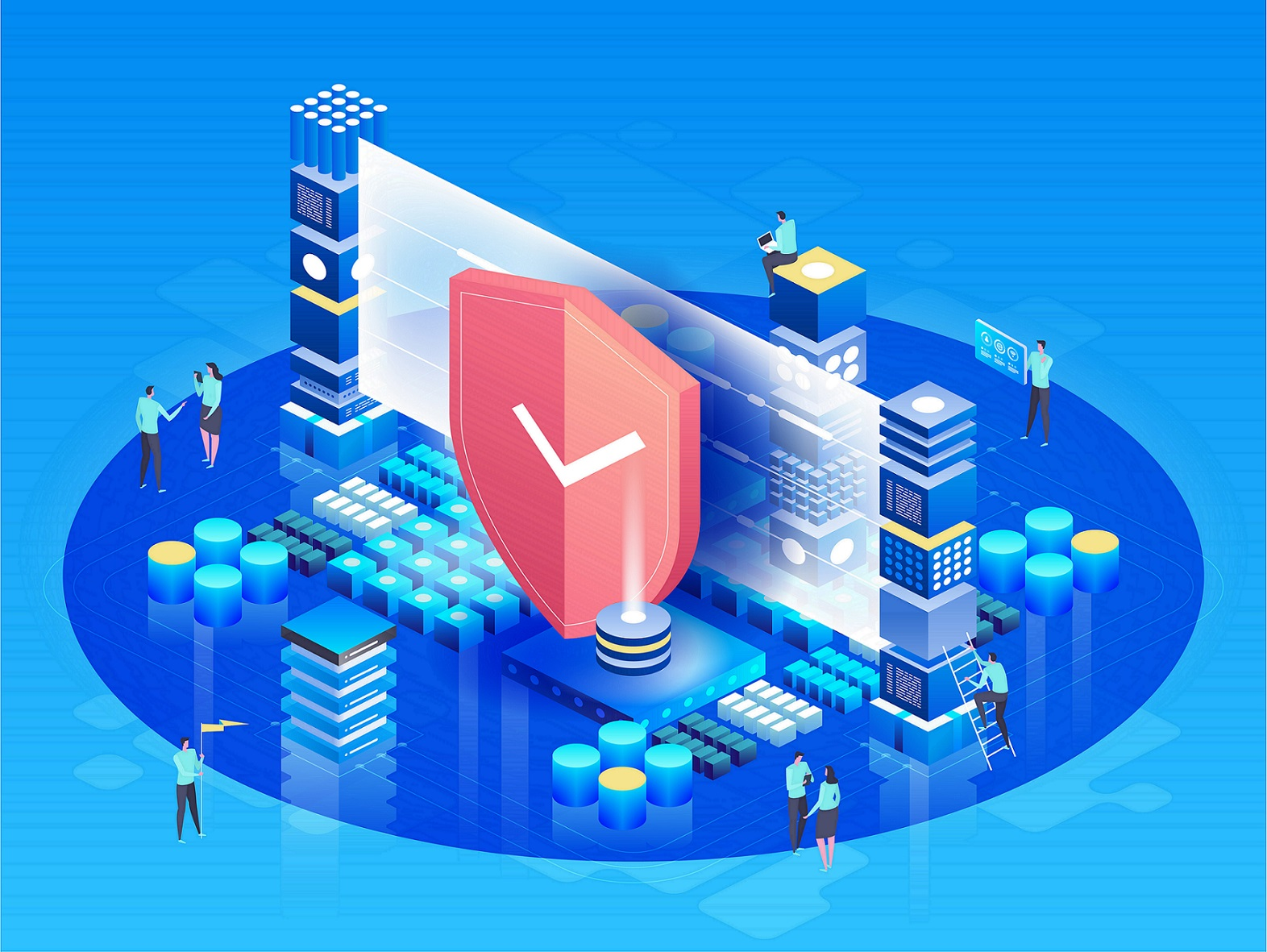
Protection - Organization
Create a Security Policy
Educating Employees
Secure the network (Firewall, IDS, IPS and ACL)
Backup of the data
Keep software up to date
Penetration Testing
Access control
Multifactor Authentication

Slide 15
Ethical Hacking

Slide 16
Ethical Hacking (Pen Testing)
Attacking a computer or a network to assess the security strength.
Hacking is usually legal as long as it is being done to find weaknesses in a computer or network system for testing purposes. This sort of hacking is what we call Ethical Hacking.
Attacker has a legal agreement with the organization to exploit the network and application
It is performed in a Test environment

Slide 17



Hackers
White Hat | A white-hat hacker is an individual who uses hacking skills to identify security vulnerabilities in hardware, software, or networks. White hat hackers only seek vulnerabilities or exploits when they are legally permitted to do so.
Black Hat | Black hat hackers are criminals who break into computer networks with malicious intent. They may also release malware that destroys files, holds computers hostage, or steals passwords, credit card numbers, and other personal information.
Grey Hat | Gray Hat hackers may have good intentions but might not disclose flows for immediate fixes. Prioritize their own perception of right versus wrong over what the law might say

Slide 18
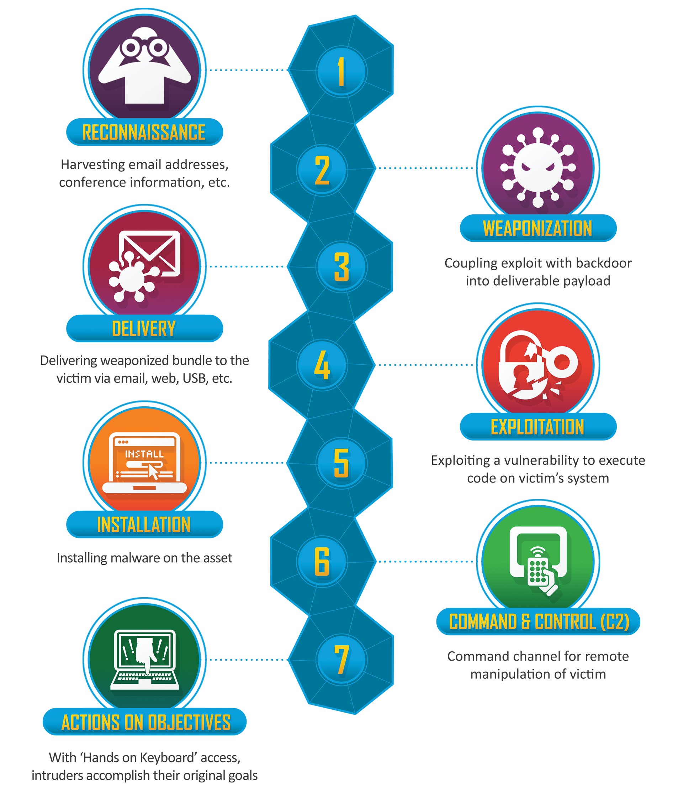
Cyber Kill Chain
Developed by Lockheed Martin
It is part of the Intelligence Driven Defense® model for the identification and prevention of cyber intrusions activity.
Website: https://www.lockheedmartin.com/en-us/capabilities/cyber/cyber-kill-chain.html

Slide 19
OWASP Top 10
OWASP Top 10:2021
A01:2021-Broken Access Control
A02:2021-Cryptographic Failures
A03:2021-Injection
A04:2021-Insecure Design
A05:2021-Security Misconfiguration
A06:2021-Vulnerable and Outdated Components
A07:2021-Identification and Authentication Failures
A08:2021-Software and Data Integrity Failures
A09:2021-Security Logging and Monitoring Failures
A10:2021-Server-Side Request Forgery
Website: https://owasp.org/Top10/

Slide 20






Tools
Nmap
Metasploit
DIRB
Burp Suite
SQLMap
Zap
Nikto
Gobuster
Greenbone

Slide 21

Demonstration
Demonstration
Source: Kali Linux (10.0.2.15)
Target: Metasploitable Ubuntu (10.0.2.4)

Slide 22
THANK YOU

